Slide 1
Night at the Library Family Engagement Project by Jenna Rizzi

Slide 2
Introduction
This night is designed to engage both parents and students in a way that establishes positive parent collaboration and increases student achievement.
Night at the Library is a home-school-community connection in which children and parents are acquainted with the public library of Montgomery Township, Mary Jacobs Library.

Slide 3
Rationale
Instilling a passion for reading and the desire to learn from books is imperative in order for students to be good readers. According to Making Meaning (Grade K), students are encouraged to make weekly visits to a library to get immersed in literature. It is no doubt that when students are immersed in literature, they are better readers and writers and boost their vocabularies (vi). I believe that good readers are also better learners. It is critical to immerse young students in literature to get their interest sparked, “hooked on books.”
It is important to show young students that there are so many kinds of literature on virtually millions of topics. There is a book for everyone. As an avid goer to three different public libraries, I believe that checking out books from the library is a truly enriching and educational experience. It is so exciting to check out a book that I cannot wait to read. I hope to instill this passion in my students. For my Kindergarteners, I hope they understand that learning to read is a challenging, exhilarating, and sometimes, frustrating process, but that it is worthwhile and valuable. Being immersed in literature and getting excited about books surely eases this process and promotes life-long learning.

Slide 4
Class Demographics
Mrs. Sheeley’s AM and PM class consists of thirty-four students in total:
fifteen females, nineteen males
Mrs. Sheeley’s students come from a variety of backgrounds and the ethnicities of the students are extremely diverse
approximately twelve different languages spoken at home
three of her students have moved to the US within the past year
I would estimate students in Mrs. Sheeley’s class come from families of middle to high SES.
I would estimate that most of the students’ parents have a college degree.
Mrs. Sheeley describes Montgomery SES as “international money.” Montgomery, Skillman, Rocky Hill and Princeton have very high taxes and are all expensive places to live in New Jersey.

Slide 5
Objectives
Prior to planning this event, I had informally assessed the need for an event like Night at the Library. After talking to many parents at Open House and Back to School Night, I realized that many of the families were new to the area and were probably unfamiliar with the library. For many of the parents I met, their Kindergartener is their first child and I considered that perhaps the parents are not aware of how enriching the library is for young students. I later asked students if they go to the public library with their parents. Approximately ten out of the thirty-four students had mentioned that they have been there. I strongly believe that this event will engage students and parents from all backgrounds in reading as well as the community.
From my findings, I devised these main objectives:
Parents and students will view frequent visits to the library as worthwhile because reading is important and exciting
Parents and students will get acquainted to the Mary Jacobs Library and obtain a library card membership

Slide 6
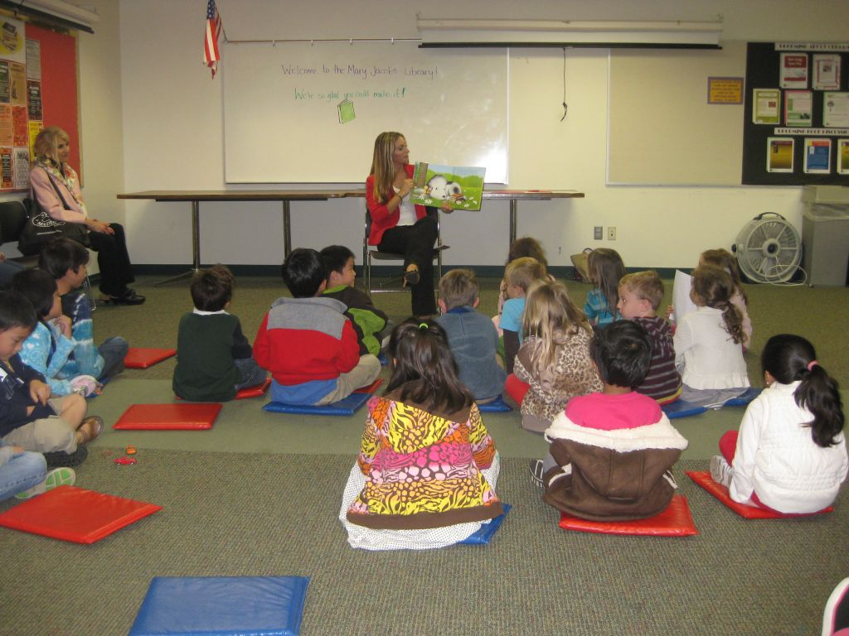
About Night at the Library
This night took place at the Montgomery public library: Mary Jacobs Library located at 64 Washington Street, Rocky Hill, NJ 08553. Night at the Library began at 7 pm on Tuesday, October 16, 2012.
The Structure:
Welcome
Tour by Karen Bilton, Children’s Media Specialist
Readings: The Best Book to Read by Debbie Bertram and How Rocket Learned to Read by Tad Hills
Book checkout and library card memberships

Slide 7
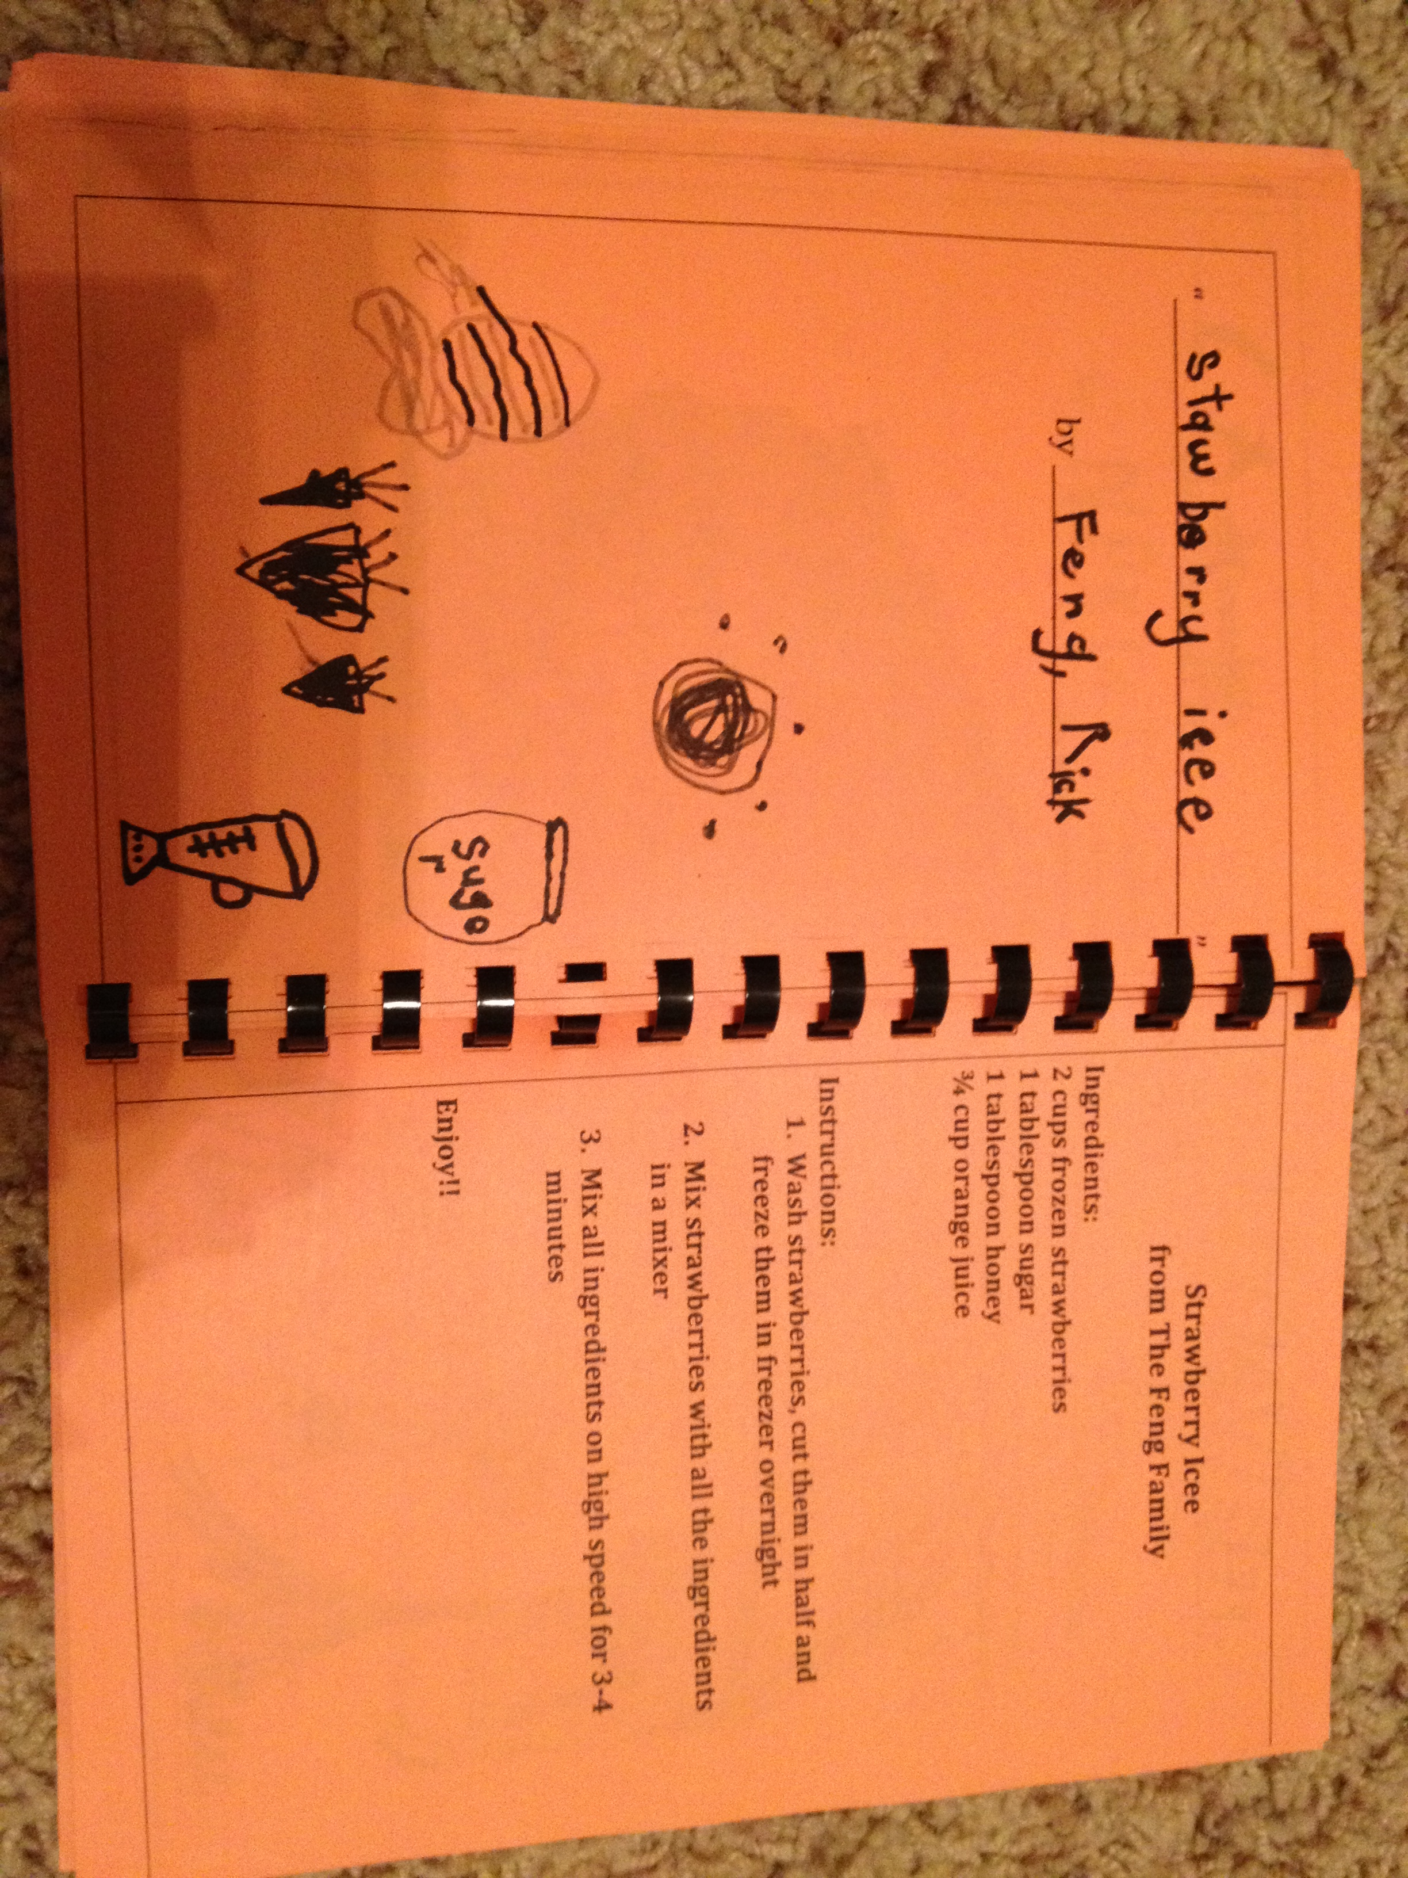
About the Recipe Book
As an added incentive to attend Ms. Rizzi’s Night at the Library, I gave out Kindergarten Cookbooks as a gift.
I had asked parents and children to work together to come up with their favorite family recipe to submit.
The parents were asked to submit the recipe for any dish that their child or family loves. The children were then asked to draw a picture of the dish or ingredients.
I compiled these recipes and illustrations into a spiral bound cookbook. I gave these to the families that attended the event. The Kindergarten Cookbook is a great way to celebrate cultural diversity in the classroom. I received recipes of all kinds from many different cultures.

Slide 8
Results
18 families attended, 51 people!
Library staff was wonderful and gave families a complete tour including the library offices, checkout desk, and most exciting for the children, the book drop!
Read Alouds and brief address to the parents were well received
I was so pleased and astonished to find that out of the eighteen families that attended, eleven registered for library cards! One student even signed up for the monthly Lego Club.
See survey here: http://www.surveymonkey.com/s/P7M2CLF

Slide 9
Results (continued)
Results of survey responses (10):
Met objectives as parents responded to how they can support their child: bring child to library, choose diverse books, spark non-fiction, discuss books, read to child often, read in practical ways (grocery list, newspaper etc.)
8 parents that answered the survey noted they obtained library cards, librarian reported that 11 had been obtained that night, 2 parents already had library memberships at the library
Seeing the children getting excited over books, their new library cards, and spending time with their families was such a fulfilling feeling. The event went even better than expected and I definitely would do it again with future classes.

Slide 10
Refinements for Future Events
For future Library Night events I would consider a few refinements:
I would consider having more literature for the parents on hand. I had the key information that I wanted parents to know in the program, but offering extra literature and pamphlets would be a nice idea.
Also depending on the size of the library, it may be wise to limit the number of people to the student and their parent(s). While I enjoyed inviting all of the families, siblings included, I found that the younger siblings could be a bit distracting.
The survey had brought to my attention that perhaps seven o’clock is a late start time for young children. One parent mentioned their child’s bedtime is 7:30 so perhaps 7:00 is a late start. I chose seven o’clock so that parents would be home from work in time. Keeping this suggestion in mind, for the next library night I would probably have it begin at six thirty or six forty five.

